Slide 1
Applied Mechanism Design For Social Good
John P Dickerson
Lecture #2 – 01/28/2021
CMSC828M
Tuesdays & Thursdays
2:00pm – 3:15pm

Slide 2

Announcements
Please check out ELMS for a join link to our Slack channel!
Should auto-join if you have a @cs.umd.edu or @umd.edu email (feel free to add your friends outside of the course!)
I think if you share the join link from Slack, anyone can join – feel free to add folks, but be reasonable!
I regret making the Slack already because people are talking about /r/WallStreetBets.

Slide 3
Wrapping up from last lecture …

Slide 4
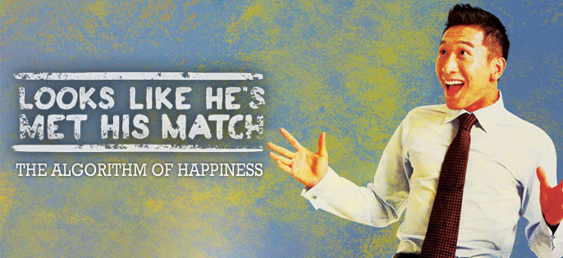
Example: Resident-Hospital Assignment
1940s: decentralized resident-hospital matching
Market “unraveled”, offers came earlier and earlier, quality of matches decreased
1950s: NRMP introduces hospital-proposing deferred acceptance algorithm
1970s: couples increasingly don’t use NRMP
1998: matching with couple constraints
(Stable matching may not exist anymore …)
Take-home message Looks like: M.D.s aren’t the only type of doctor who help people!

Slide 5
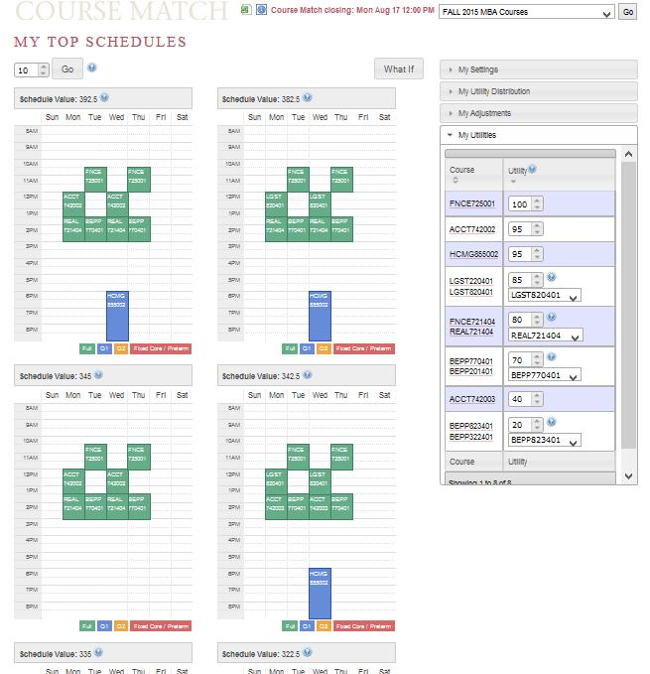
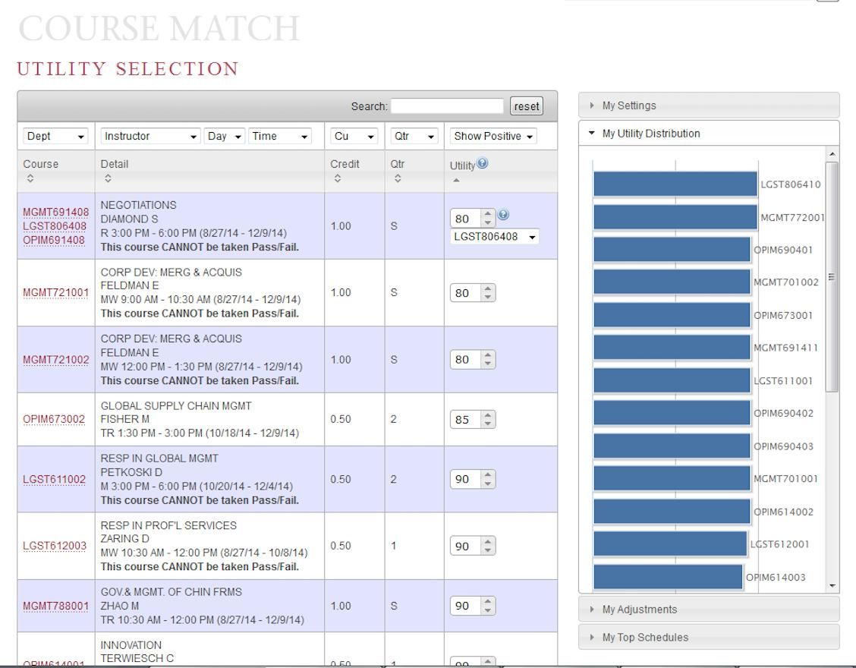
Example: Combinatorial course allocation [Images from Budish et al. working paper 2016]
Bidding
Dynamic exclusions
“Funny money” used for bidding

Slide 6
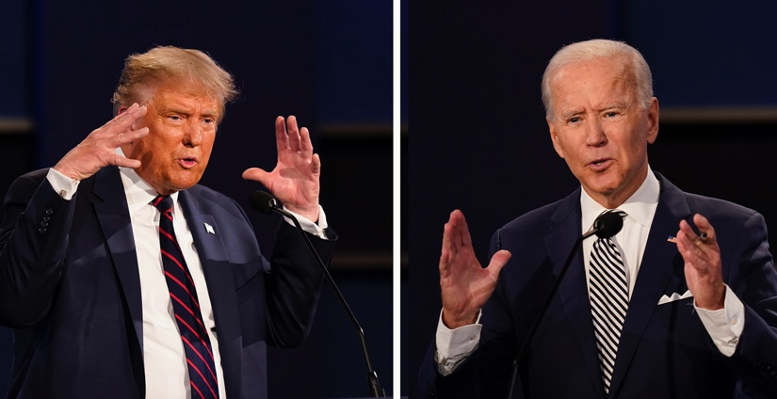
Example: Voting
Set of voters N and a set of alternatives: {Joe Biden, Bernie Sanders, Donald Trump}
Each voter ranks the candidates:
v₁: Donald Trump > Bernie > Joe Biden
v₂: Joe Biden > Bernie > Donald Trump
… A preference profile is the set of all voters’ rankings
Can we choose a voting rule – that is, a function that takes preference profiles and returns a winning alternative – that:
“Behaves well”
Isn’t manipulable by strategic agents

Slide 7

Example: fair allocation
Divisible goods:
Splitting land, cutting cake
Indivisible goods:
Splitting up assets after divorce (house, cars, pets)
A chief concern: defining and guaranteeing the fairness of the final allocation
An allocation is envy free if each player values her own allocated set of goods at least as highly as any other player’s allocated set
When do envy-free allocations exist? How can we compute them? What can we do when they don’t exist?
http://spliddit.org

Slide 8
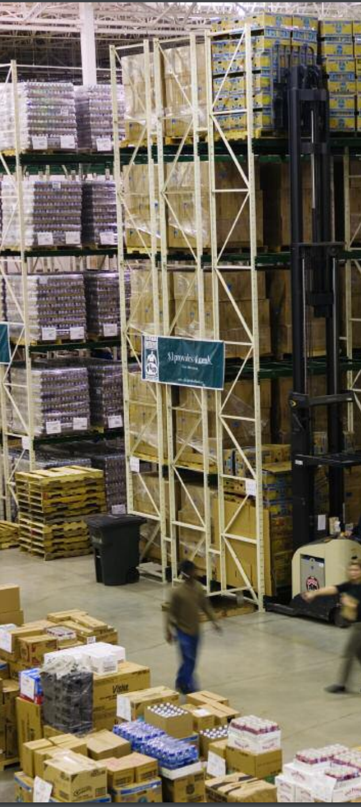
Example: Food Bank Allocation
Food banks supply nutrition to the needy for free or at a reduced cost
Much of that food comes from donors (e.g. supermarkets, manufacturers)
Distribution is overseen by a large non-profit organization, Feeding America
Previously: centralized allocation based on perceived need of food banks
Currently: food banks bid in an online auction using a fake currency for loads of donated food.

Slide 9
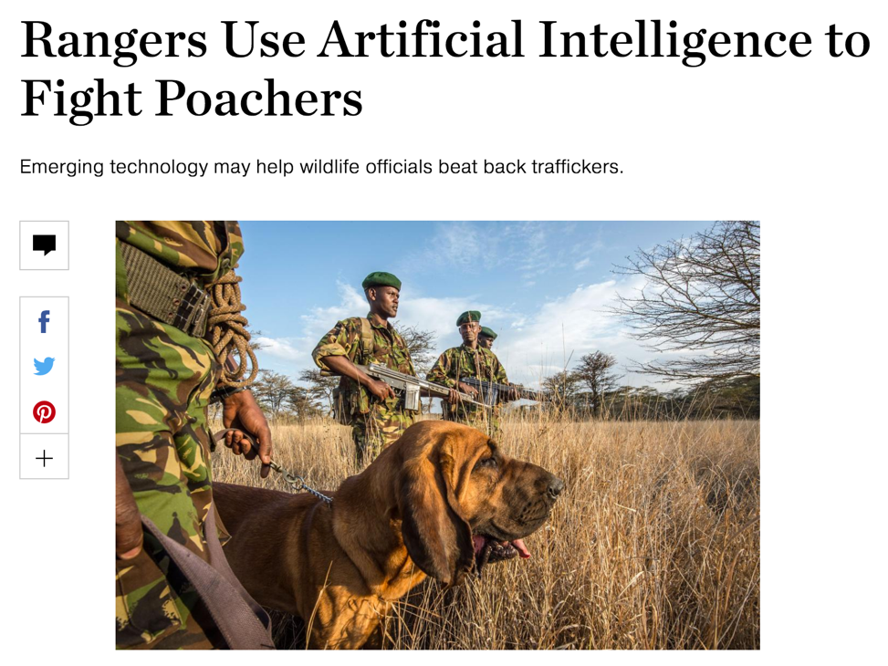
Example: Security GAmes
Where should we deploy security forces (checkpoints, cop cars, dogs, troops), assuming a rational adversary who can observe our deployment strategy?
Checkpoints at airports
Patrol routes on the water on the borders
Anti-poacher teams near big game
How do we compute these strategies?
What if the adversary isn’t rational?

Slide 10

Example: Kidney Transplantation
US waitlist: over 100,000
35-37k added each year
4,537 people died while waiting
11,559 people received a kidney from the deceased donor waitlist
5,283 people received a kidney from a living donor
Some through kidney exchanges
(We work extensively with the UNOS exchange.)
Demand
Supply
[Roth et al. 2004]

Slide 11
Example: Deceased-Donor Allocation
Online bipartite matching problem:
Set of patients is known (roughly) in advance
Organs arrive and must be dispatched quickly
Constraints:
Locality: organs only stay good for 24 hours
Blood type, tissue type, etc.
Who gets the organ? Prioritization based on:
Age?
QALY maximization?
Quality of match?
Time on the waiting list?

Slide 12




Example: Kidney Exchange
Wife
Husband
D₁ P₁
Donors
Patients
D₂ P₂
Brother
Brother
(2- and 3-cycles, all surgeries performed simultaneously)

Slide 13
Non-directed donors & chains
[Rees et al. 2009]
NDD
D1
D2
D3
…
Pay it forward
P1
P2
P3
Not executed simultaneously, so no length cap required based on logistic concerns …
… but in practice edges fail, so some finite cap is used!

Slide 14
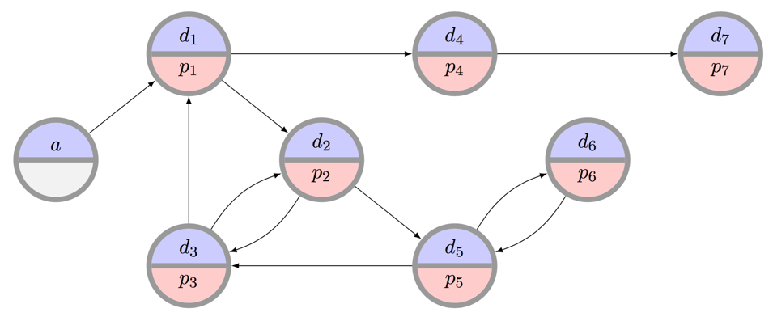

Example: Kidney Exchange
What is the “best” matching objective?
Maximize matches right now or over time?
Maximize transplants or matches?
Prioritization schemes (i.e. fairness)?
Modeling choices?
Incentives? Ethics? Legality?
Can we design a mechanism that performs well in practice, is computationally tractable, and is understandable by humans?

Slide 15
Techniques we’ll use (THIS + Next Two lectures will cover these, In the context of Mechanism Design)

Slide 16
Combinatorial Optimization
Combinatorial optimization lets us select the “best element” from a set of elements.
Some PTIME problems:
Some forms of matching
2-player zero-sum Nash
Compact LPs
Some PPAD- or NP-hard problems:
More complex forms of matching
Many equilibrium computations
Some > NP-hard problems:
Randomizing over a set of all feasible X, where all feasible X must be enumerated (#P-complete)

Slide 17
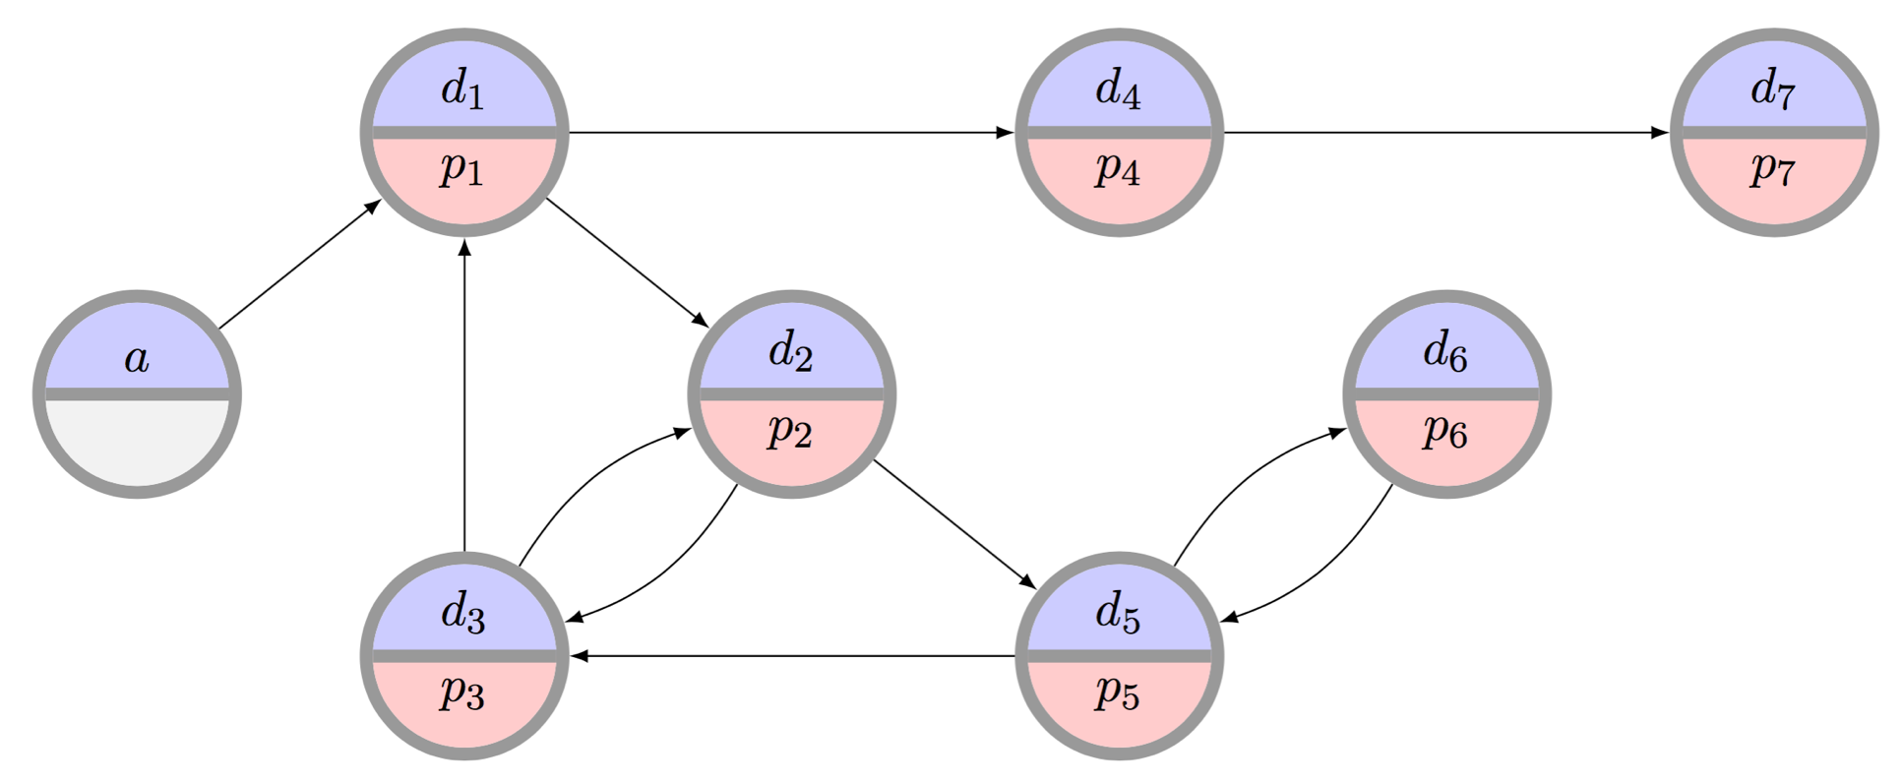
C.O. for Kidney Exchange: Refresher on Problem

Slide 18
C.O. for Kidney Exchange: The Edge formulation
[Abraham et al. 2007]
Binary variable x_{ij} for each edge from i to j
Maximize
u(M) = Σ w_{ij} x_{ij}
Subject to
Σ_{j} x_{ij} = Σ_{j} x_{ji} for each vertex i
Σ_{j} x_{ij} ≤ 1 for each vertex i
Σ_{1≤k≤L} x_{i(k)i(k+1)} ≤ L-1 for paths i(1)…i(L+1)
(no path of length L that doesn’t end where it started – cycle cap)
Flow constraint

Slide 19
C.O. For Kidney Exchange: The Cycle Formulation
[Roth et al. 2004, 2005,
Abraham et al. 2007]
Binary variable x_{c} for each feasible cycle or chain c
Maximize
u(M) = Σ w_{c} x_{c}
Subject to
Σ_{c : i in c} x_{c} ≤ 1 for each vertex i

Slide 20
C.O. For Kidney Exchange: Comparison
Tradeoffs in number of variables, constraints
IP #1: O(|E|^{L}) constraints vs. O(|V|) for IP #2
IP #1: O(|V|²) variables vs. O(|V|^{L}) for IP #2
IP #2’s relaxation is weakly tighter than #1’s. Quick intuition in one direction:
Take a length L+1 cycle. #2’s LP relaxation is 0.
#1’s LP relaxation is (L+1)/2 – with ½ on each edge
Recent work focuses on balancing tight LP relaxations and model size [Constantino et al. 2013, Glorie et al. 2014, Klimentova et al. 2014, Alvelos et al. 2015, Anderson et al. 2015, Mak-Hau 2015, Manlove&O’Malley 2015, Plaut et al. 2016, …]:
We will discuss (~about a month, possibly with Duncan) new compact formulations, some with tightest relaxations known, all amenable to failure-aware matching

Slide 21
Game Theory & Mechanism Design
We assume participants in our mechanisms are:
Selfish utility maximizers
Rational (typically – sometimes relaxed)
Game theory & M.D. give us the language to describe desirable properties of mechanisms:
Incentive compatibility
Individual rationality
Efficiency

Slide 22
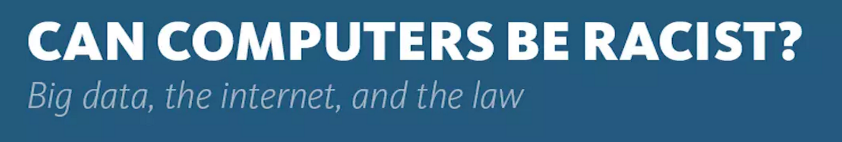
Machine learning
Predicting supply and demand
Computing optimal matching/allocation policies:
MDPs
RL
POMDPs, if you’re feeling brave/masochistic
And: recent work looks at fairness and discrimination in machine learning – interesting project discussion, see Slack!
“… when a search was performed on a name that was “racially associated” with the black community, the results were much more likely to be accompanied by an ad suggesting that the person had a criminal record—regardless of whether or not they did.”

Slide 23
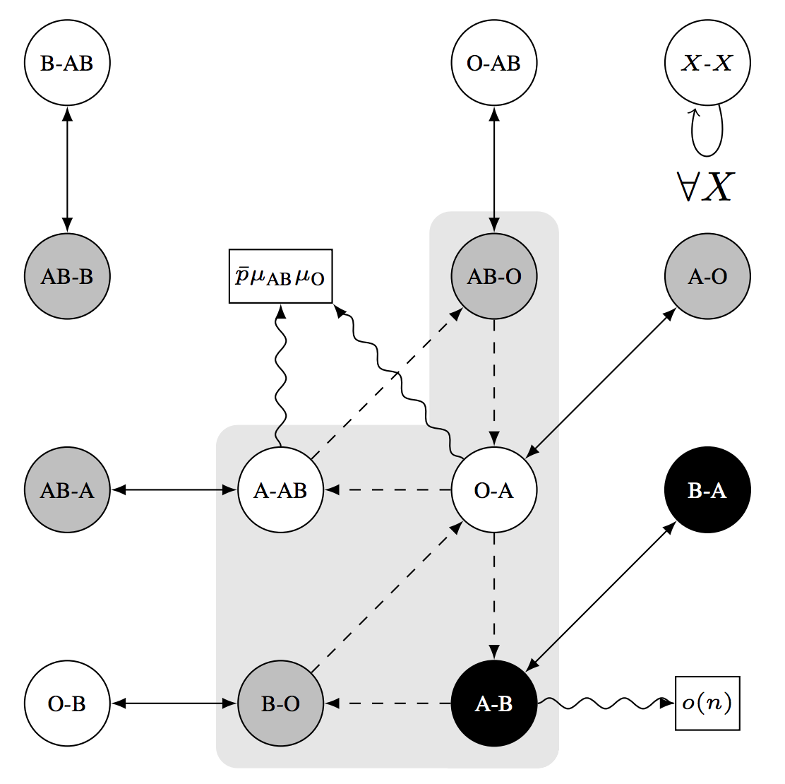
Random Graph Theory
(Might cover a bit in the matching and barter exchange lectures; talk to me.)

Slide 24
Next This class: Game Theory Primer
Thanks to: AGT book, Blum (AB), Conitzer (VC), Sandholm (TS), Osborne&Rubinstein (OR)

Slide 25
What is game theory?
“… the study of mathematical models of conflict and cooperation between intelligent rational decision-makers.”
“Intelligent rational decision-makers” = agents
Have individual preferences specified by utility functions
Can take different actions (or randomize over them)
Utility of agents usually, but not always, depends on the actions of other agents
What’s best for me is a function of what’s best for you …
… which is a function of what’s best for me ...
... which is a function of what’s best for you ...
... which is …

Slide 26
What is “Utility” …?
“ … utility is a measure of preferences over some set of goods and services.”
Formally:
Let O be the set of outcomes (e.g., O = {{apple,orange}, {apple}, {orange}, { }})
A utility function u : O → ℜ ranks outcomes, and represents a preference relation p over the set of outcomes O
Example:
u({apple,orange}) = 5
u({apple}) = u({orange}) = 3
u({ }) = 0 → { } p {apple} p {orange} p {apple,orange}

Slide 27
How do we measure “Utility” …?
u({apple,orange}) = 5
5 dollars? 5 clams? 5 days to live?
Standard: 5 “utils” – it doesn’t typically matter
Agent’s behavior under u(o) is typically the same as under u’(o) = a + b*u(o)
u({apple}) = 3 < 5 = u({apple,orange})
Cardinal utility: 3 < 5
(We’ll see this in security games and auctions)
Ordinal utility: {apple,orange} p {apple}
Doesn’t encode strength of a preference, just ordering
(We’ll see more of this in social choice)

Slide 28
Risk attitudes
Which would you prefer?
A lottery ticket that pays out $10 with probability .5 and $0 otherwise, or
A lottery ticket that pays out $3 with probability 1
How about:
A lottery ticket that pays out $100,000,000 with probability .5 and $0 otherwise, or
A lottery ticket that pays out $30,000,000 with probability 1
Usually, people do not simply go by expected value
VC

Slide 29
Risk Attitudes – Expected Value
An agent is risk-neutral if she only cares about the expected value of the lottery ticket
An agent is risk-averse if she always prefers the expected value of the lottery ticket to the lottery ticket
Most people are like this
An agent is risk-seeking if she always prefers the lottery ticket to the expected value of the lottery ticket
VC

Slide 30
Decreasing marginal utility
Typically, at some point, having an extra dollar does not make people much happier (decreasing marginal utility)
“Typically”
utility
buy a nicer car (utility = 3)
buy a car (utility = 2)
buy a bike (utility = 1)
$200
$1500
$5000
money
VC

Slide 31
Maximizing expected utility
utility
buy a nicer car (utility = 3)
buy a car (utility = 2)
buy a bike (utility = 1)
$200
$1500
$5000
money
Lottery 1: get $1500 with probability 1 → gives expected utility 2
Lottery 2: get $5000 with probability .4, $200 otherwise
→ expected utility .4*3 + .6*1 = 1.8
E$[Lottery 2] = .4*$5000 + .6*$200 = $2120 > $1500 = E$[Lottery 1]
So: maximizing expected utility is consistent with risk aversion (assuming decreasing marginal utility)
VC

Slide 32
risk attitudes Assuming expected utility max’Ing
utility
money
Green has decreasing marginal utility → risk-averse
Blue has constant marginal utility → risk-neutral
Red has increasing marginal utility → risk-seeking
Grey’s marginal utility is sometimes increasing, sometimes decreasing → neither risk-averse (everywhere) nor risk-seeking (everywhere)
VC

Slide 33
Strategies & Utility
A strategy s_{i} for agent i is a mapping of history/the agent’s knowledge of the world to actions
Pure: “perform action x with probability 1”
Randomized: “do x with prob 0.2 and y with prob 0.8”
A strategy set is the set of strategies available to agent i
Can be infinite (infinite number of actions, randomization)
A strategy profile is an instantiation (s₁, s₂, s₃, …, s_{N})
Abuse of notation: we’ll use s_{-i} to refer to all strategies played other than that by agent i
i = 2, then s_{-i} = (s₁, s₃, ..., s_{N})
Utils awarded after game is played: u_{i} = u_{i}(s_{i}, s_{-i})

Slide 34
Nature
Agents act strategically in the face of what they believe other agents will do, who act based on …
There may be other sources of non-strategic randomness
Included (when needed) in our models as a unique agent called nature, which acts:
Probabilistically
Without reasoning about what other agents will do
(Sometimes referred to as agent i = 0, often just nature.)

Slide 35
Game Representations
Column player aka. player 2 (simultaneously) chooses a column
0, 0 | -1, 1 | 1, -1
1, -1 | 0, 0 | -1, 1
-1, 1 | 1, -1 | 0, 0
Row player aka. player 1 chooses a row
A row or column is called an action or (pure) strategy
Row player’s utility is always listed first, column player’s second
Zero-sum game: the utilities in each entry sum to 0 (or a constant)
Three-player game would be a 3D table with 3 utilities per entry, etc.
VC

Slide 36
Game representations
Matrix form
(aka normal form
aka strategic form)
Extensive form
(aka tree form)
player 2’s strategy
Left
1, 2
Left,
Left
Left,
Right
Right,
Left
Right,
Right
Up
player 2
Right
3, 4
Up
1, 2
1, 2
3, 4
3, 4
player 1’s
strategy
player 1
Left
5, 6
Down
5, 6
7, 8
5, 6
7, 8
Down
player 2
Right
7, 8
Potential combinatorial explosion
TS

Slide 37
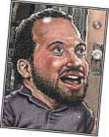

Seinfeld’s Rock-Paper-Scissors
MICKEY: All right, rock beats paper! (Mickey smacks Kramer's hand for losing) KRAMER: I thought paper covered rock. MICKEY: Nah, rock flies right through paper. KRAMER: What beats rock? MICKEY: (looks at hand) Nothing beats rock.
0, 0 | 1, -1 | 1, -1
-1, 1 | 0, 0 | -1, 1
-1, 1 | 1, -1 | 0, 0
VC

Slide 38
Dominance
Player i’s strategy s_{i} strictly dominates s_{i}’ if
for any s_{-i}, u_{i}(s_{i} , s_{-i}) > u_{i}(s_{i}’, s_{-i})
s_{i} weakly dominates s_{i}’ if
for any s_{-i}, u_{i}(s_{i} , s_{-i}) ≥ u_{i}(s_{i}’, s_{-i}); and
for some s_{-i}, u_{i}(s_{i} , s_{-i}) > u_{i}(s_{i}’, s_{-i})
0, 0 | 1, -1 | 1, -1
-1, 1 | 0, 0 | -1, 1
-1, 1 | 1, -1 | 0, 0
strict dominance
weak dominance
VC

Slide 39
Mixed strategies & Dominance
Mixed strategy for player i = probability distribution over player i’s (pure) strategies
E.g.,1/3 , 1/3 , 1/3
Example of dominance by a mixed strategy:
3, 0 | 0, 0
0, 0 | 3, 0
1, 0 | 1, 0
?????????
1/2
Usage:
σ_{i} denotes a mixed strategy,
s_{i} denotes a pure strategy
1/2
VC

Slide 40
Best-response strategies
Suppose you know your opponent’s mixed strategy
E.g., your opponent plays rock 50% of the time and scissors 50%
What is the best strategy for you to play?
Rock gives .5*0 + .5*1 = .5
Paper gives .5*1 + .5*(-1) = 0
Scissors gives .5*(-1) + .5*0 = -.5
So the best response to this opponent strategy is to (always) play rock
There is always some pure strategy that is a best response
Suppose you have a mixed strategy that is a best response; then every one of the pure strategies that that mixed strategy places positive probability on must also be a best response
VC

Slide 41
Dominant strategy equilibriA (DSE)
Best response s_{i}*: for all s_{i}’, u_{i}(s_{i}*,s_{-i}) ≥ u_{i}(s_{i}’,s_{-i})
Dominant strategy s_{i}*: s_{i}* is a best response for all s_{-i}
Does not always exist
Inferior strategies are called “dominated”
DSE is a strategy profile where each agent has picked its dominant strategy
Requires no counterspeculation – just enumeration
cooperate
defect
Pareto optimal?
cooperate
3, 3
0, 5
Social welfare
maximizing?
defect
5, 0
1, 1
TS
Notes:
JPD: Pareto efficient = all of them; SW max = (3,3), DSE is defect-defect

Slide 42
Zero-Sum Games (2-P)
Two-player zero-sum games are a special – purely competitive – case of general games
Everything I win you lose, and vice versa
Example: heads-up poker (with no rake)
A minimax-optimal strategy is a strategy that maximizes the expected minimum gain
Guarantees the “best minimum” in expectation, no matter which strategy your opponent selects
Theorem [von Neumann ’28] – “Minimax Theorem”:
Every 2-P zero-sum game has a unique value V
Maximin utility: max_{σi} min_{s-i} u_{i}(σ_{i}, s_{-i}) (= - min_{σi} max_{s-i} u_{-i}(σ_{i}, s_{-i}))
Minimax utility: min_{σ-i} max_{si} u_{i}(s_{i}, σ_{-i}) (= - max_{σ-i} min_{si} u_{-i}(s_{i}, σ_{-i}))
Theorem: V = max_{σi} min_{s-i} u_{i}(σ_{i}, s_{-i}) = min_{σ-i} max_{si} u_{i}(s_{i}, σ_{-i})
+1, -1
-2, +2
+2, -2
0, 0
Notes:
JPD: Mention we can find minimax-optimal (and thus 2P zero-sum Nash) in PTIME, in two lectures via e.g. LP solving, but not for general games (PPAD-c for Nash even for 2P non-zero-sum).

Slide 43
General-sum games (2-P)
You could still play a minimax strategy in general-sum games
i.e., pretend that the opponent is only trying to hurt you
But this is not rational:
Col
0, 0 | 3, 1
1, 0 | 2, 1
Row
If Col were trying to hurt Row, Col would play Left, so Row should play Down
In reality, Col will play Right (strictly dominant), so Row should play Up
Is there a better generalization of minimax strategies in zero-sum games to general-sum games?
VC

Slide 44
General-Sum Games: Nash Equilibria (2-P)
Nash equilibrium: a pair of strategies that are stable
Stable: neither agent has incentive to deviate from his or her selected strategy on their own
Theorem [Nash 1950]: any general-sum game has at least one Nash equilibrium
Might require mixed strategies (randomization)
Corollary for 2-P zero-sum games: Minimax Theorem!
WLOG pick one of the NE, let V = value of Row player
Assumed NE, so neither player can do better (even fully knowing the other player’s mixed strategy!) → minimax-opt
Col
2, 2 | -1, -1
-1, -1 | 2, 2
????????
Row
Notes:
NE: (Left, Up) or (Right, Down) or ((0.5Left, 0.5Right), (0.5Up, 0.5Down))

Slide 45
Example: Chicken
Dodge
Straight
S
D
D
S
D
0, 0 | -1, 1
1, -1 | -5, -5
????????
????????
S
Thankfully, (D, S) and (S, D) are Nash equilibria
They are pure-strategy Nash equilibria: nobody randomizes
They are also strict Nash equilibria: changing your strategy will make you strictly worse off
No other pure-strategy Nash equilibria
VC

Slide 46
Chicken
D
S
D
0, 0 | -1, 1
1, -1 | -5, -5
Is there an NE that uses mixed strategies?
Say, where player 1 uses a mixed strategy?
Note: if a mixed strategy is a best response, then all of the pure strategies that it randomizes over must also be best responses
So we need to make player 1 indifferent between D and S
Player 1’s utility for playing D = -p^{c}_{S}
Player 1’s utility for playing S = p^{c}_{D} - 5p^{c}_{S} = 1 - 6p^{c}_{S}
So we need -p^{c}_{S} = 1 - 6p^{c}_{S} which means p^{c}_{S} = 1/5
Then, player 2 needs to be indifferent as well
Mixed-strategy Nash equilibrium: ((4/5 D, 1/5 S), (4/5 D, 1/5 S))
People may die! Expected utility -1/5 for each player
S
VC

Slide 47
Criticisms of Nash equilibrium
Not unique in all games (like the example on Slide 31)
Approaches for addressing this problem
Refinements (=strengthenings) of the equilibrium concept
Eliminate weakly dominated strategies first (IEDS)
Choose the Nash equilibrium with highest welfare
Subgame perfection … [see AGT book on course page]
Mediation, communication, convention, learning, …
Collusions amongst agents not handled well
“No agent wants to deviate on her own”
Can be disastrous to “partially” play an NE
(More) people may die!
Correlated equilibria – strategies selected by an outsider, but the strategies must be stable (see Chp 2.7 of AGT)
TS, AGT

Slide 48
Correlated equilibrium
Suppose there is a trustworthy mediator who has offered to help out the players in the game
The mediator chooses a profile of pure strategies, perhaps randomly, then tells each player what her strategy is in the profile (but not what the other players’ strategies are)
A correlated equilibrium is a distribution over pure-strategy profiles so that every player wants to follow the recommendation of the mediator (if she assumes that the others do so as well)
Every Nash equilibrium is also a correlated equilibrium
Corresponds to mediator choosing players’ recommendations independently
… but not vice versa
(Note: there are more general definitions of correlated equilibrium, but it can be shown that they do not allow you to do anything more than this definition.)
VC

Slide 49
C.E. for Chicken
D
S
D
0, 0 | -1, 1
1, -1 | -5, -5
20%
40%
S
40%
0%
Why is this a correlated equilibrium?
Suppose the mediator tells Row to Dodge
From Row’s perspective, the conditional probability that Col was told to Dodge is 20% / (20% + 40%) = 1/3
So the expected utility of Dodging is (2/3)*(-1) = -2/3
But the expected utility of Straight is (1/3)*1 + (2/3)*(-5) = -3
So Row wants to follow the recommendation
If Row is told to go Straight, he knows that Col was told to Dodge, so again Row wants to follow the recommendation
Similar for Col

Slide 50
Complexity
Can compute minimax-optimal strategies in PTIME
Can compute 2-P zero-sum NE in PTIME
(We’ll see this as an example during the convex optimization primer lecture next week.)
Can compute correlated equilibria in PTIME
Unknown if we can compute a 2-P general-sum NE in PTIME:
Known: PPAD-complete (weaker than NP-c, and different)
All known algorithms require worst-cast exponential time
Our first “meaty” lectures will cover security games, which try to find Stackelberg equilibria:
Varying complexity, will discuss during those lectures
Notes:
PPAD-c vs NP-c: recall, every game has a Nash Equilibrium! This is unlike NP-c problems like SAT where we’re asking if/if not satisfiable. Different analysis used, weaker than NP-c. Could be that P = PPAD != NP.

Slide 51
Does Nash Model Human Behavior?
Game: pick a number (let’s say, integer) in {0, 1, 2, 3, …, 98, 99, 100}
Winner: person who picks number that is closest to 2/3 of the average of all numbers
Example: if the average of all numbers is 54, your best answer would be 36 ( = 54 * 2/3)
LIVE EXPERIMENT!

Slide 52
Does Nash Model Human Behavior?
What’s the (Nash) equilibrium strategy?
“Level 0” humans: everyone picks randomly? E[v] = 50, choose 50 * 2/3
“Level 1” humans: everyone picks 50 * 2/3, I’ll pick (50 * 2/3) * 2/3
“Level 2” humans: I’ll pick ((50 * 2/3) * 2/3) * 2/3 …
N.E.: fixed point, “Level infinity”, pick 0 or 1 depending on constraints

Slide 53
Does Nash Model Human Behavior?
Any guesses on behavior …?

Slide 54
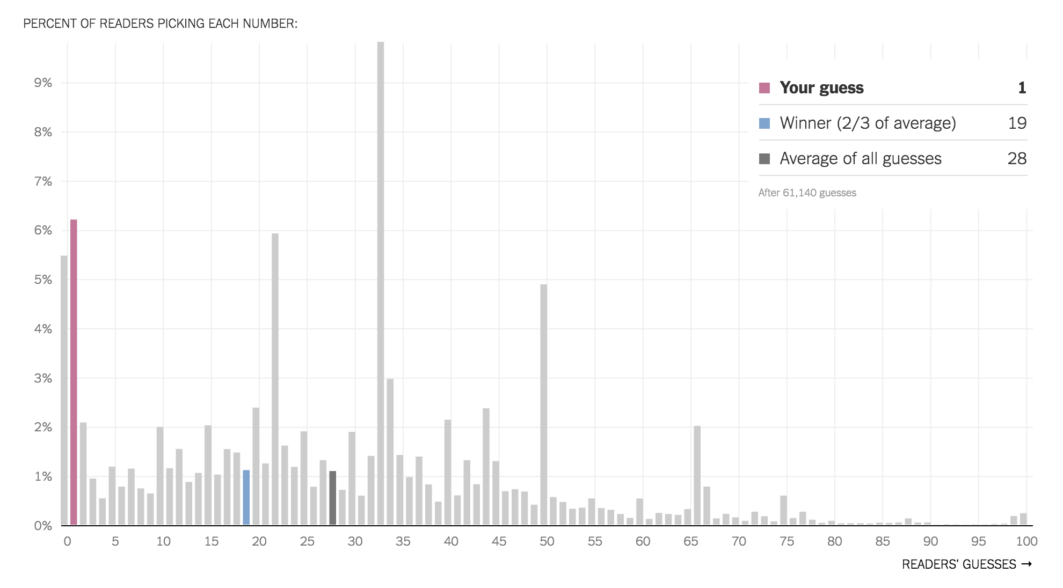
NY Times

Slide 55
Next class: Mechanism Design Primer

